Slide 1
MECHRÍ
Sabato 13 maggio 2017
ore 15.00-18.30
crocevia dei linguaggi: Diritto e Biologia

Slide 2
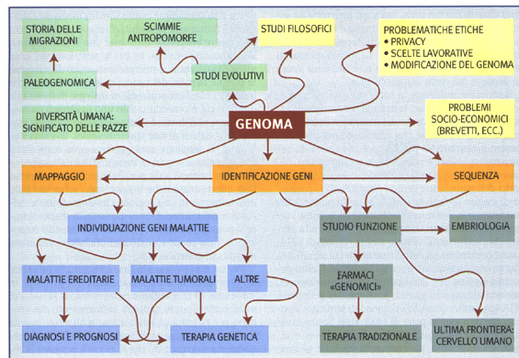

Slide 3
How are the law ant the Courts involved ?
Science is universal
Laws and the Courts are national expressions.
Is it always/still true ?

Slide 4
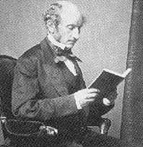
On Liberty by John Stuart Mill

Slide 5
On Liberty by John Stuart Mill
“… there is a sphere of action in which society, as distinguished from the individual, has, if any, only an indirect interest;
comprehending all that portion of a person's life and conduct which affects only himself, or, if it also affects others, only with their free, voluntary, and undeceived consent and participation.”
“… the appropriate region of human liberty…”

Slide 6
On Liberty by John Stuart Mill
“It comprises, first, the inward domain of consciousness”
“Secondly, the principle requires liberty of tastes and pursuits; of framing the plan of our life to suit our own character; of doing as we like, subject to such consequences as may follow; without impediment from our fellow-creatures, so long as what we do does not harm them even though they should think our conduct foolish, perverse, or wrong.
Thirdly, follows the liberty of combination among individuals; freedom to unite, for any purpose not involving harm to others: the persons combining being supposed to be of full age, and not forced or deceived.”

Slide 7
On Liberty by John Stuart Mill
Two basic assumptions
Society v. individuals
Individual v. each other individual

Slide 8
New situations and conflicts (a)
The Icelandic Supreme Court (27 November, 2003) upheld the right of a woman to prohibit the transfer of her daughter’s dead father’s information into the Health Sector Database.
The reason is that it is possible to infer, from the data, information relating to her father’s hereditary characteristics which could also apply to herself.

Slide 9
New situations and conflicts (b)
Mr. Harman throws a brick from a bridge, which crashs through a lorry windscreen;
the brick hits the driver’s chest and kill him;
Police obtains the offender’s DNA profile from blood left on the brick;
thanks to familial searching, Police identify a brother of the offender who was in the NDNAD;
Police question Mr. Harman and he confesses the crime.

Slide 10
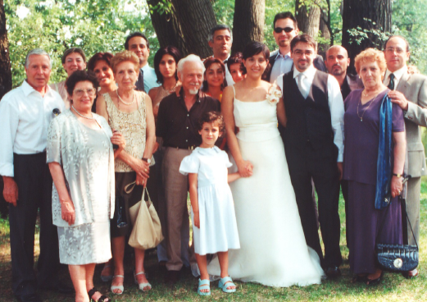


Slide 11
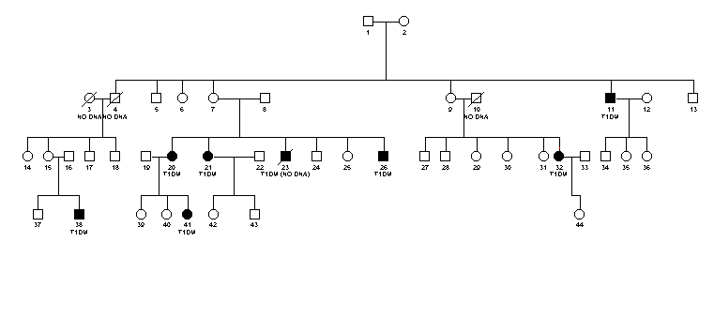

Slide 12
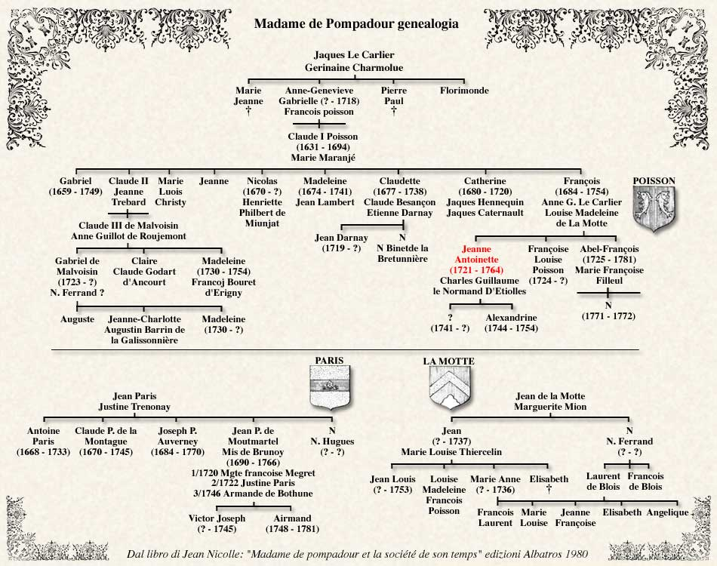
P a t r i a r c h y

Slide 13

What about these cases ?
Does the Mill’s principle encompass these new conflicts ?

Slide 14
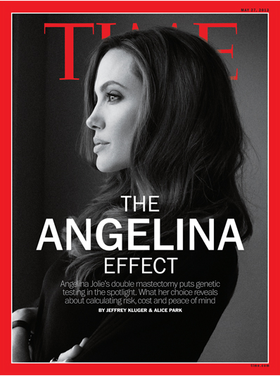
Notes:
14

Slide 15
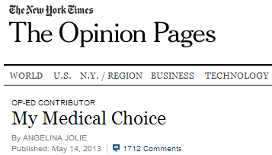

Notes:
15

Slide 16
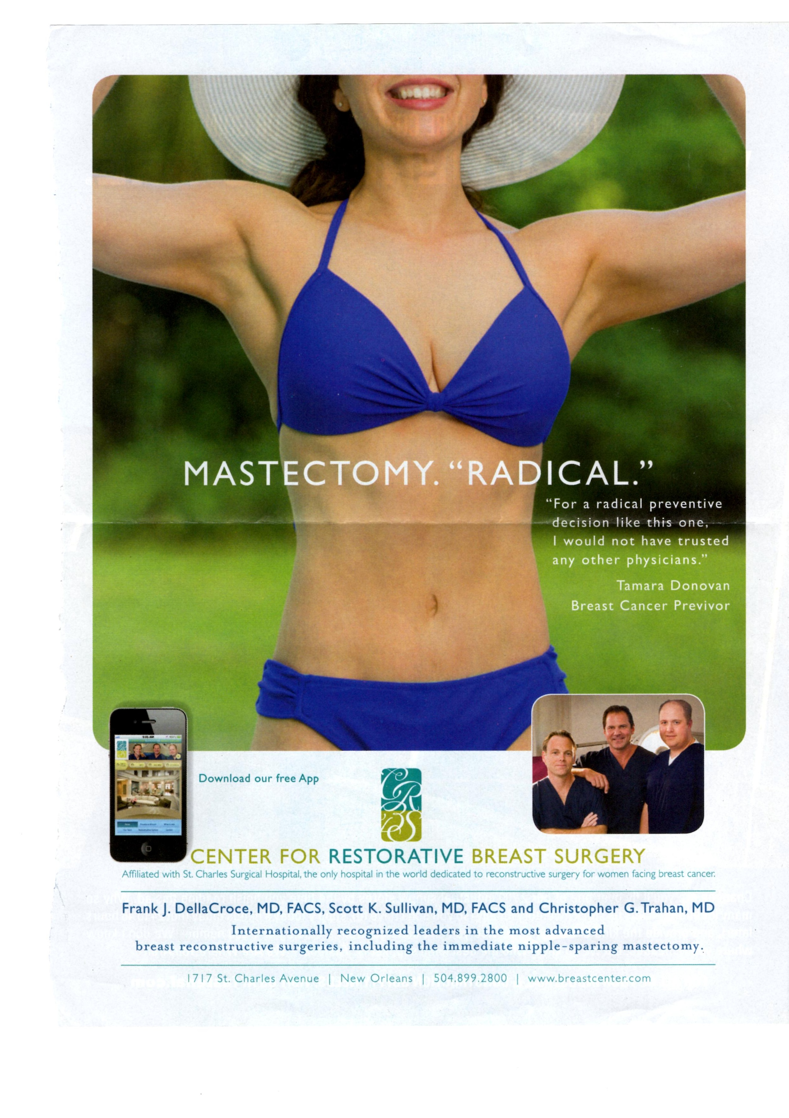

Slide 17
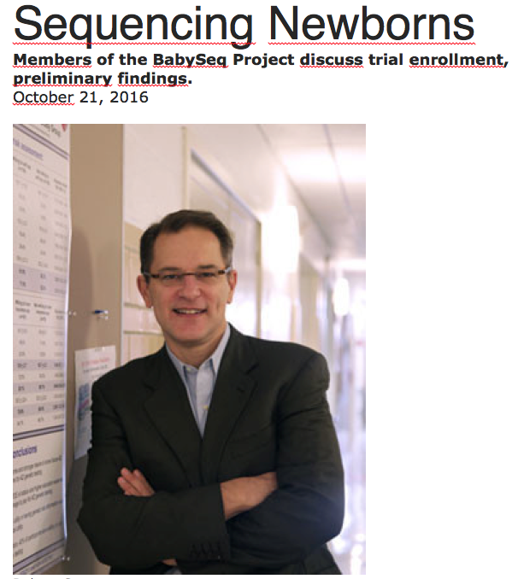

Slide 18
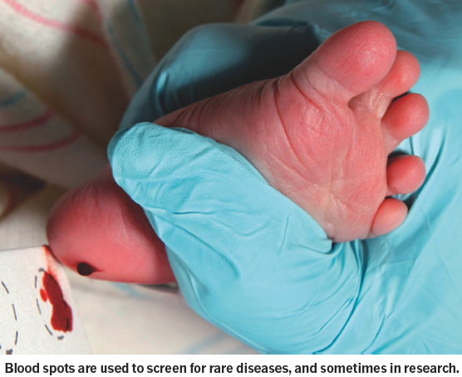

Slide 19
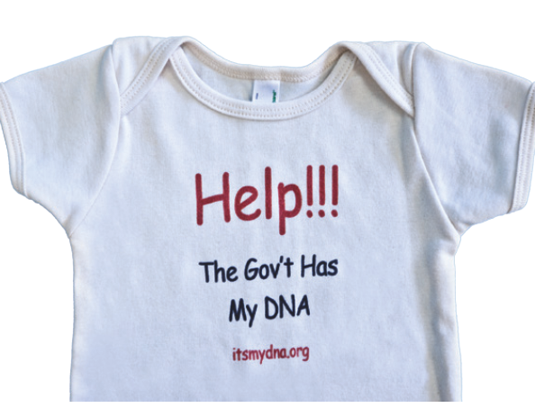

Slide 20
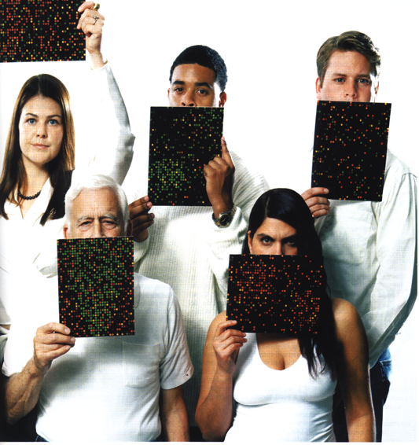
A glance at the future In the future, biologists will likely be able to give each of us a genetic report card that will spell out our risk of developing a variety of different diseases

Slide 21
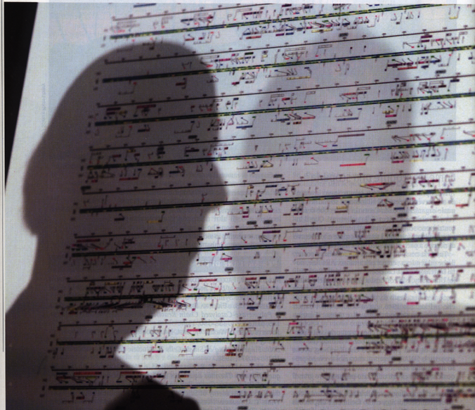
genetic report card
will we really want that information? How will it be used? Who will have access our genetic information? How will it affect our lives, our families, and our communities?
What is the problem?

Slide 22
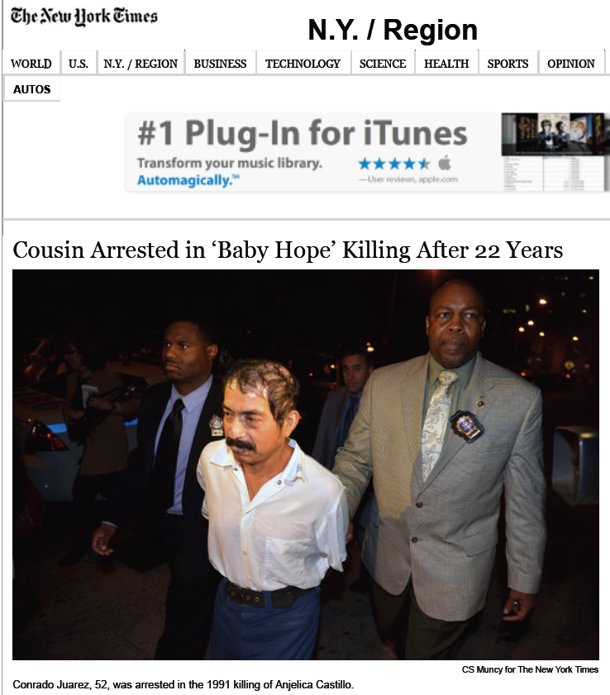

Slide 23
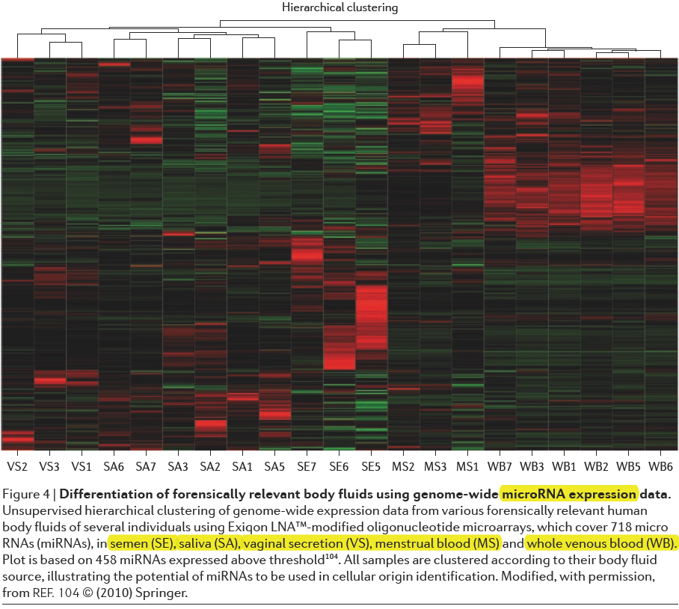

Slide 24
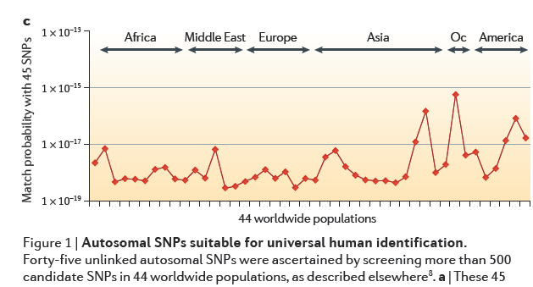

Slide 25
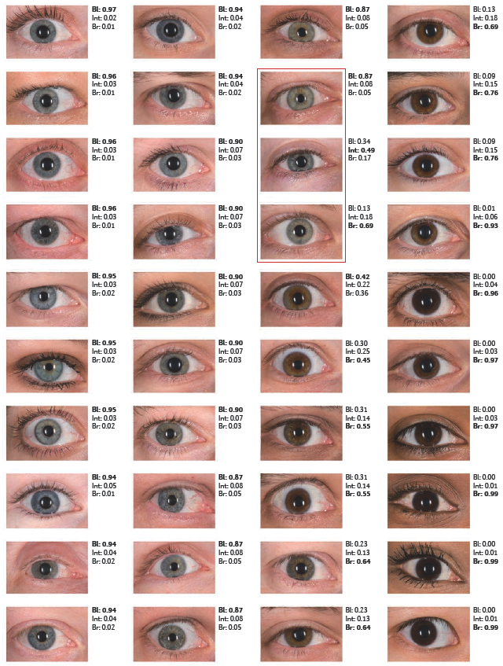
to find unknown persons:
this approach is known as
forensic DNA phenotyping (FDP)
and includes the inference of
biogeographic ancestry (BA)
and
externally visible characteristics (EVCs)
from DNA.

Slide 26
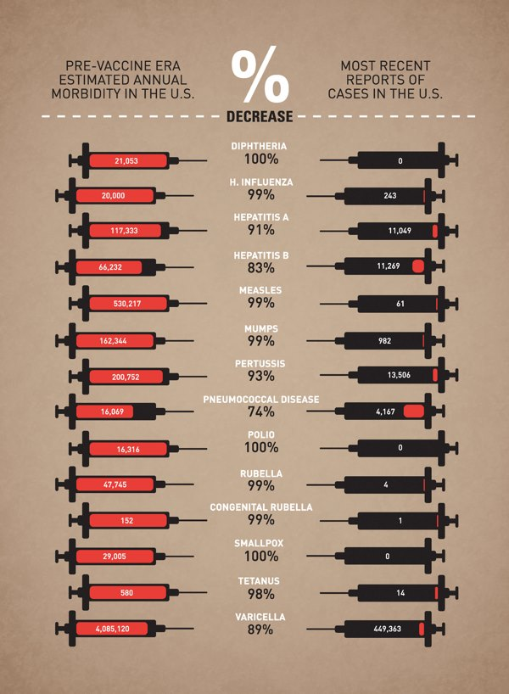

Slide 27
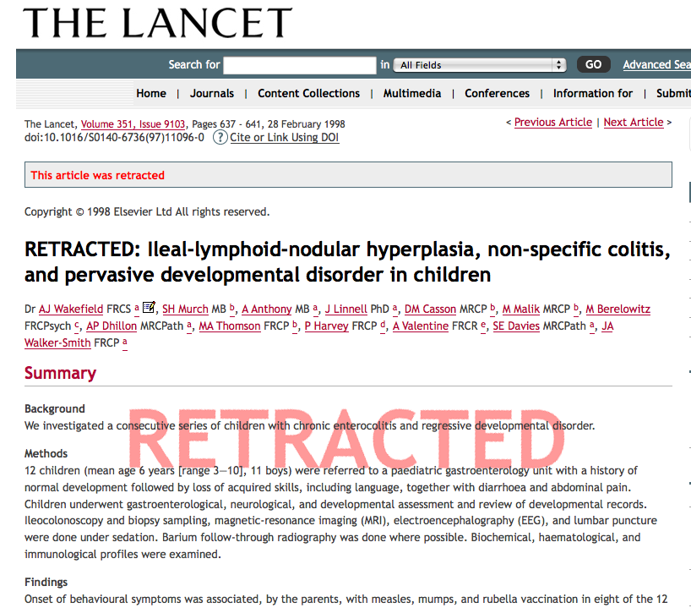

Slide 28
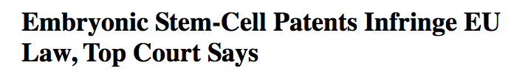
Oliver Brüstle contro Greenpeace eV
LA CORTE (Grande Sezione)
Per questi motivi, la Corte (Grande Sezione) dichiara:
1) L’art. 6, n. 2, lett. c), della direttiva del Parlamento europeo
e del Consiglio 6 luglio 1998, 98/44/CE, sulla protezione giuridica
delle invenzioni biotecnologiche, deve essere interpretato nel senso che:
– costituisce un «embrione umano» qualunque ovulo umano
fin dalla fecondazione, qualunque ovulo umano non fecondato in cui
sia stato impiantato il nucleo di una cellula umana matura e qualunque
ovulo umano non fecondato che, attraverso partenogenesi, sia stato
indotto a dividersi e a svilupparsi;
– spetta al giudice nazionale stabilire, in considerazione degli sviluppi
della scienza, se una cellula staminale ricavata da un embrione umano
nello stadio di blastocisti costituisca un «embrione umano» ai sensi
dell’art. 6, n. 2, lett. c), della direttiva 98/44.
2) L’esclusione dalla brevettabilità relativa all’utilizzazione di embrioni
umani a fini industriali o commerciali enunciata all’art. 6, n. 2, lett. c),
della direttiva 98/44 riguarda altresì l’utilizzazione a fini di ricerca scientifica,
mentre solo l’utilizzazione per finalità terapeutiche o diagnostiche che
si applichi all’embrione umano e sia utile a quest’ultimo può essere
oggetto di un brevetto.

Slide 29
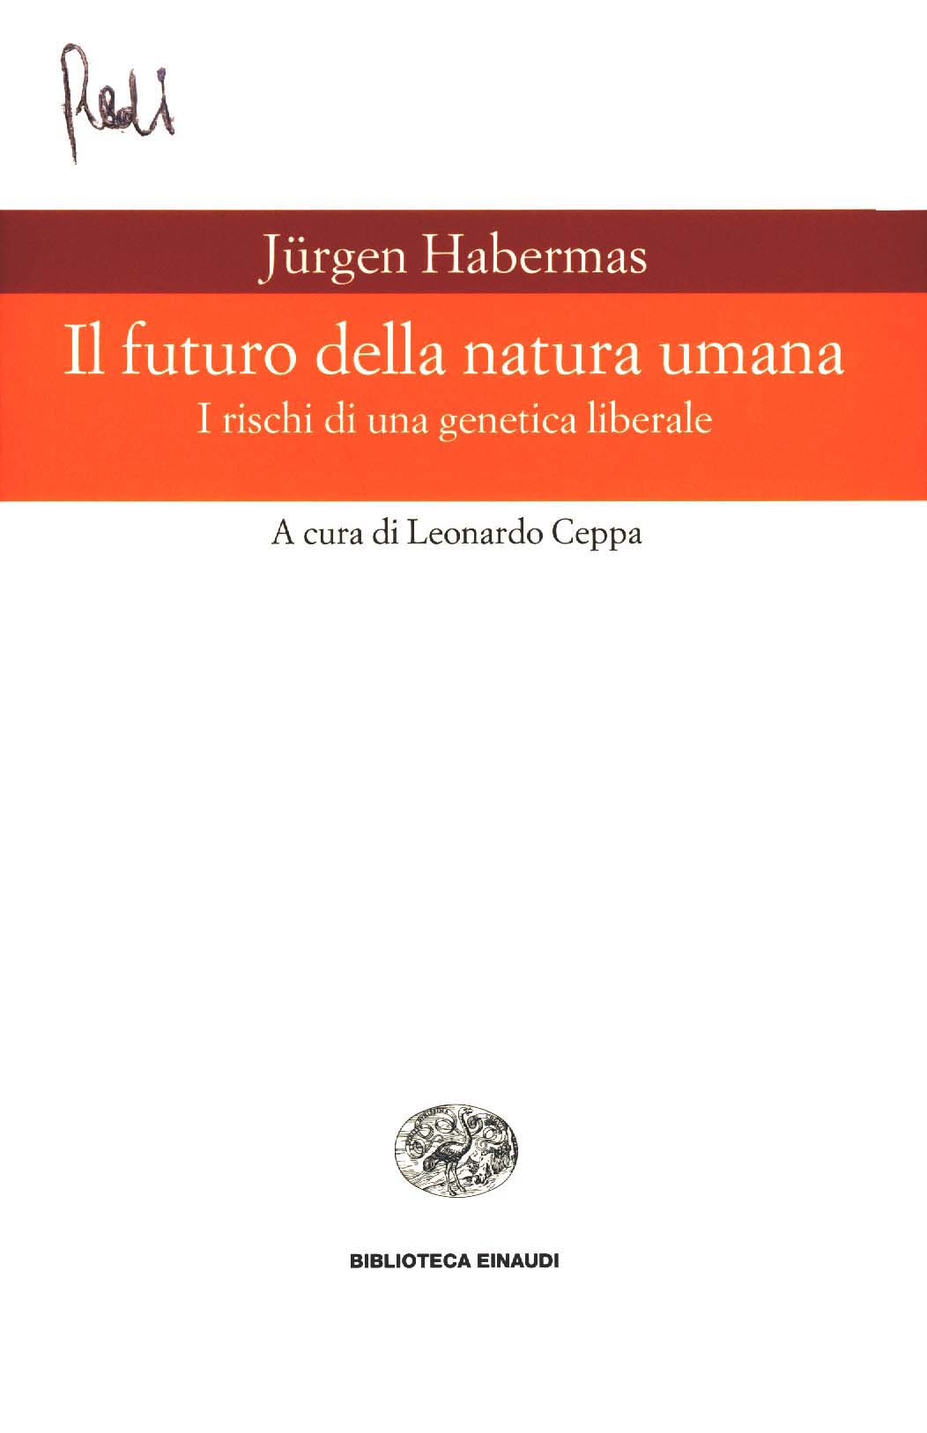

Slide 30
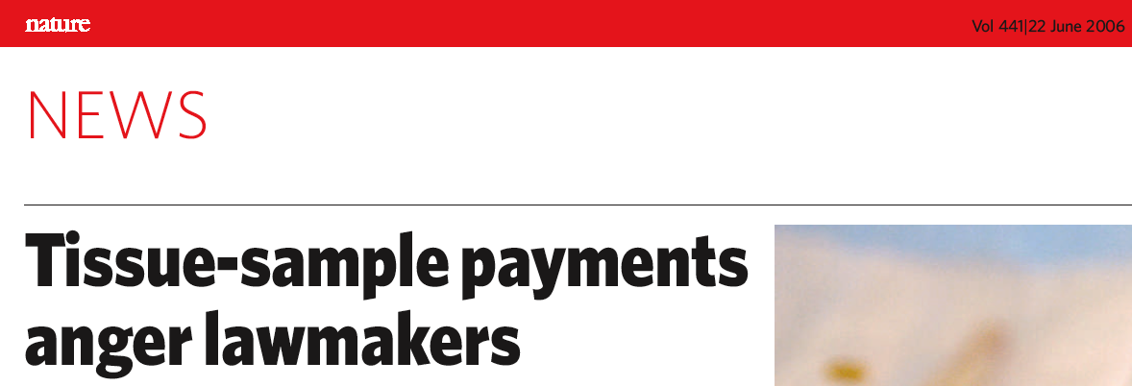

Slide 31


Slide 32
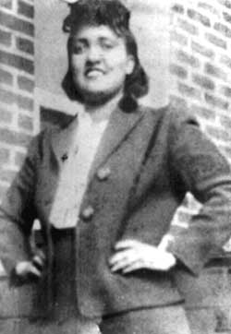
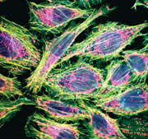
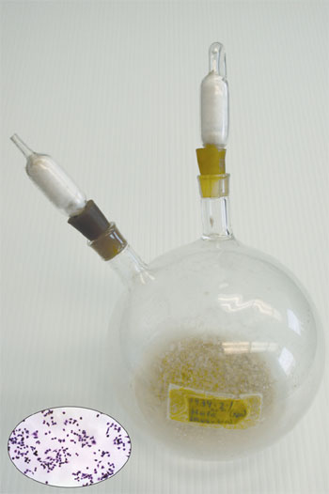
HeLa cells
since 1951 self-replicating
used in thousands biol exp
contribution to medicine
Henrietta Lacks
1920 - 1951
HeLa cancer cells have evolved into a
self-replicating, single-cell life-form.
HeLa cells should be given the new species name of Helacyton gartleri.
The cells are a genetic chimera of HPV18 and human cervical cells and now have a distinct, stable, non-human chromosome number.

Slide 33
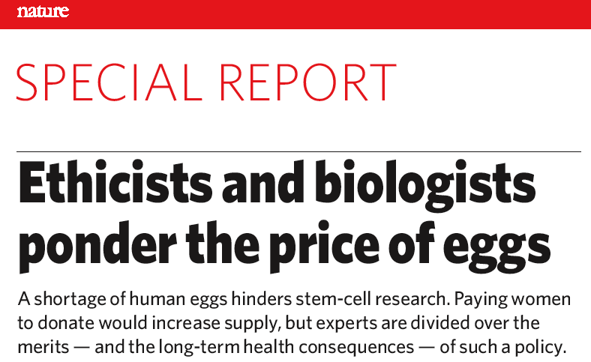


Slide 34
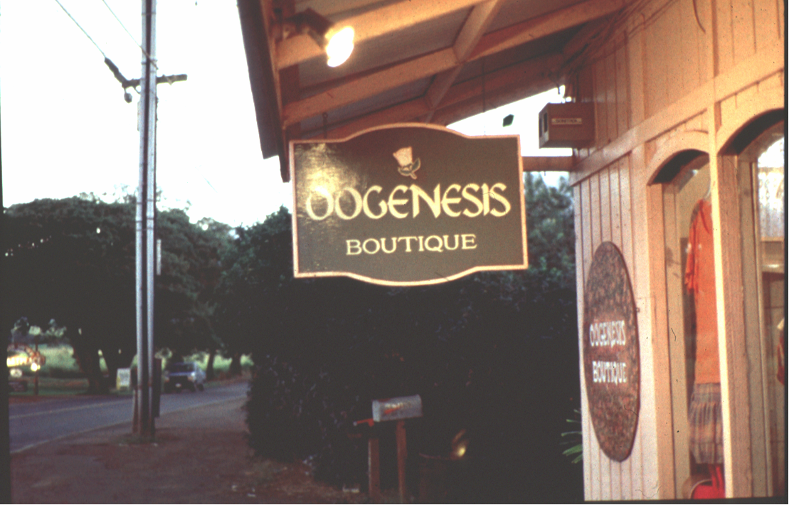

Slide 35
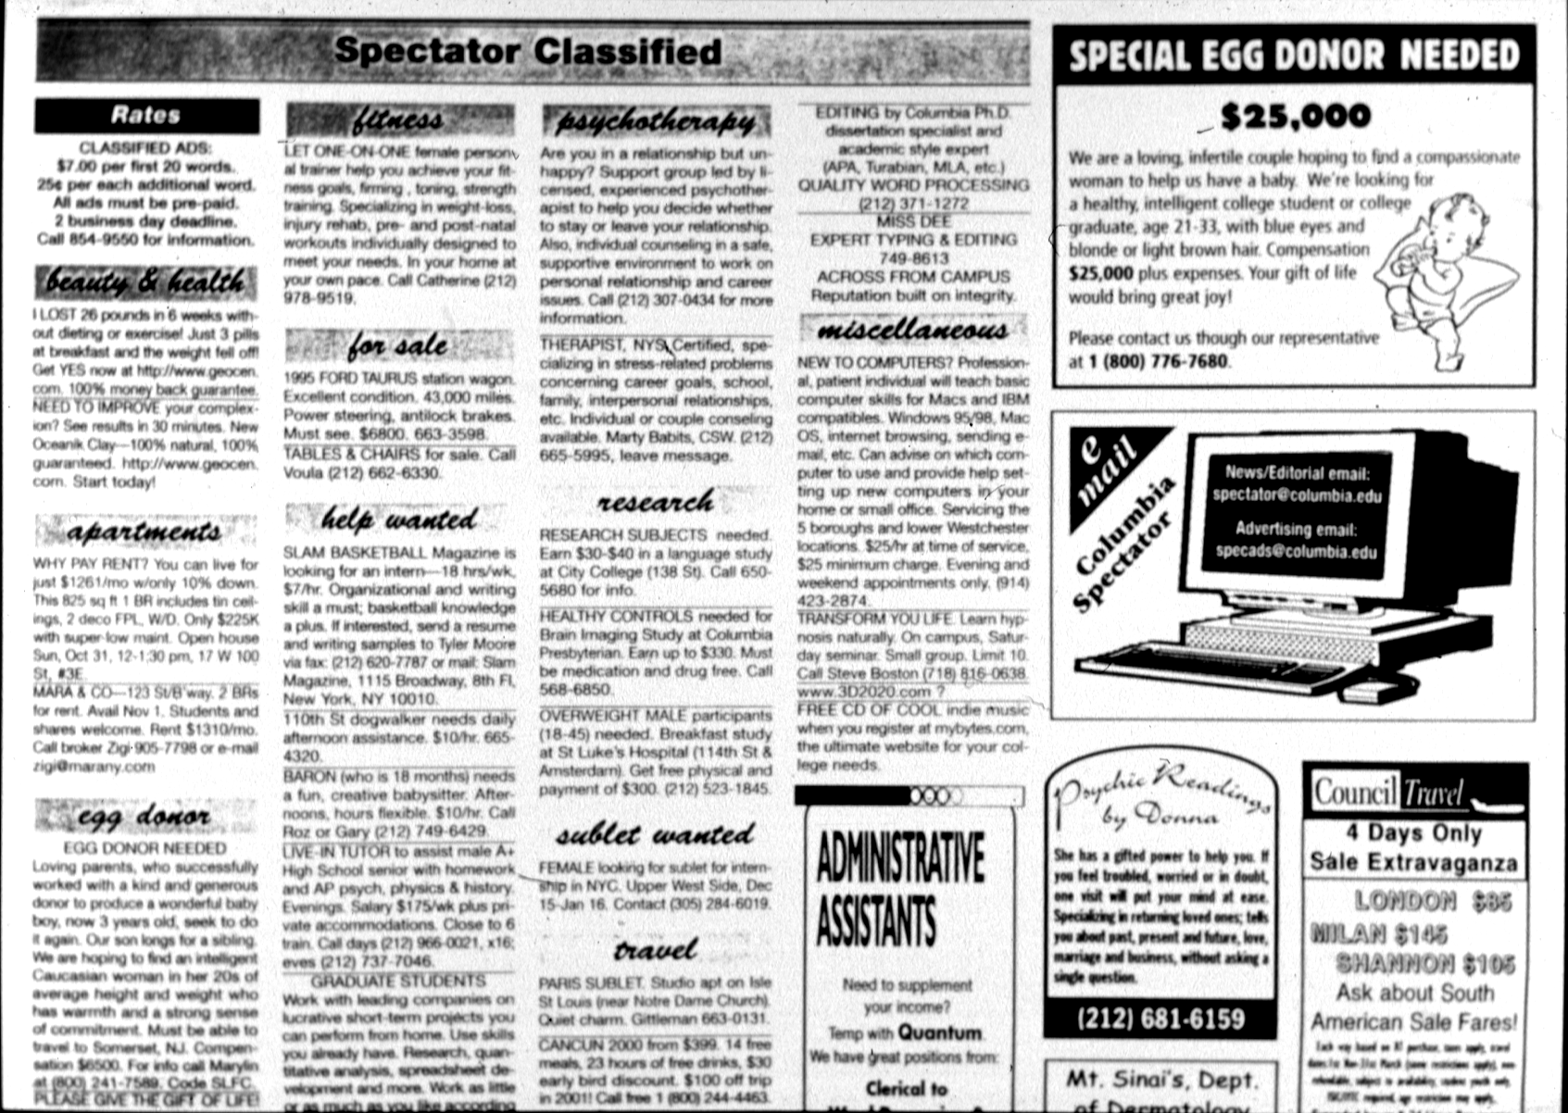

Slide 36
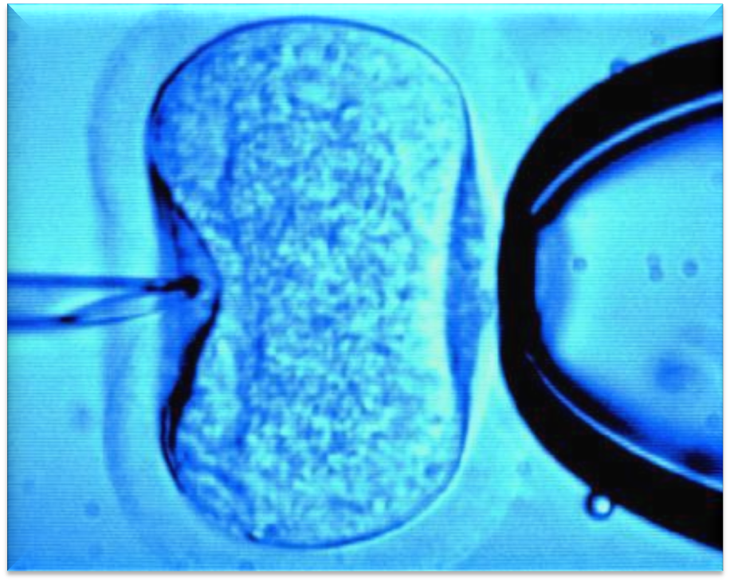
In vitro fertilization
Notes:
36

Slide 37
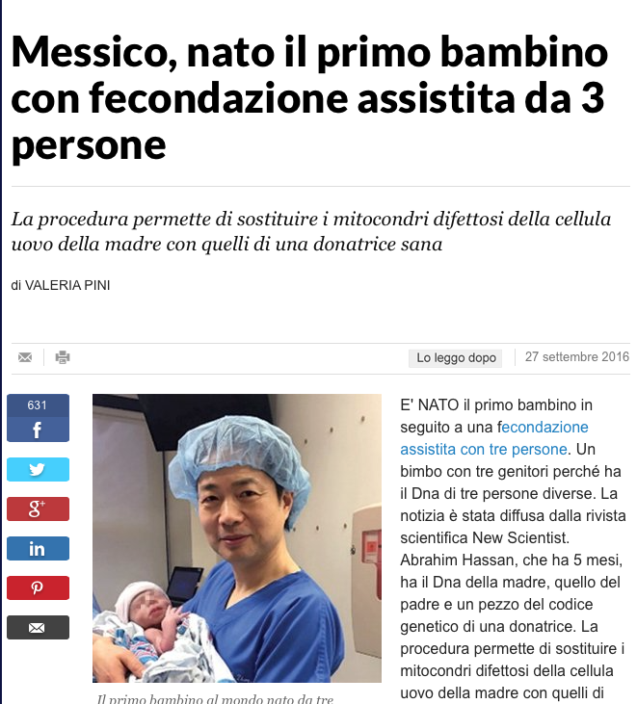
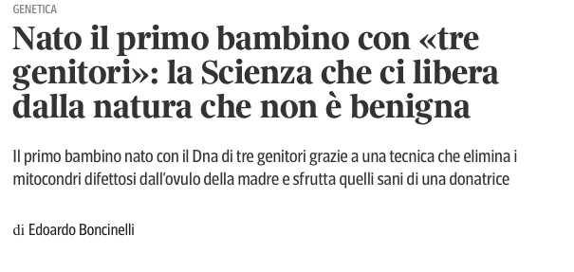
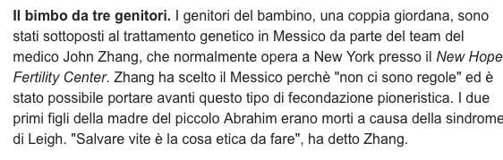

Slide 38
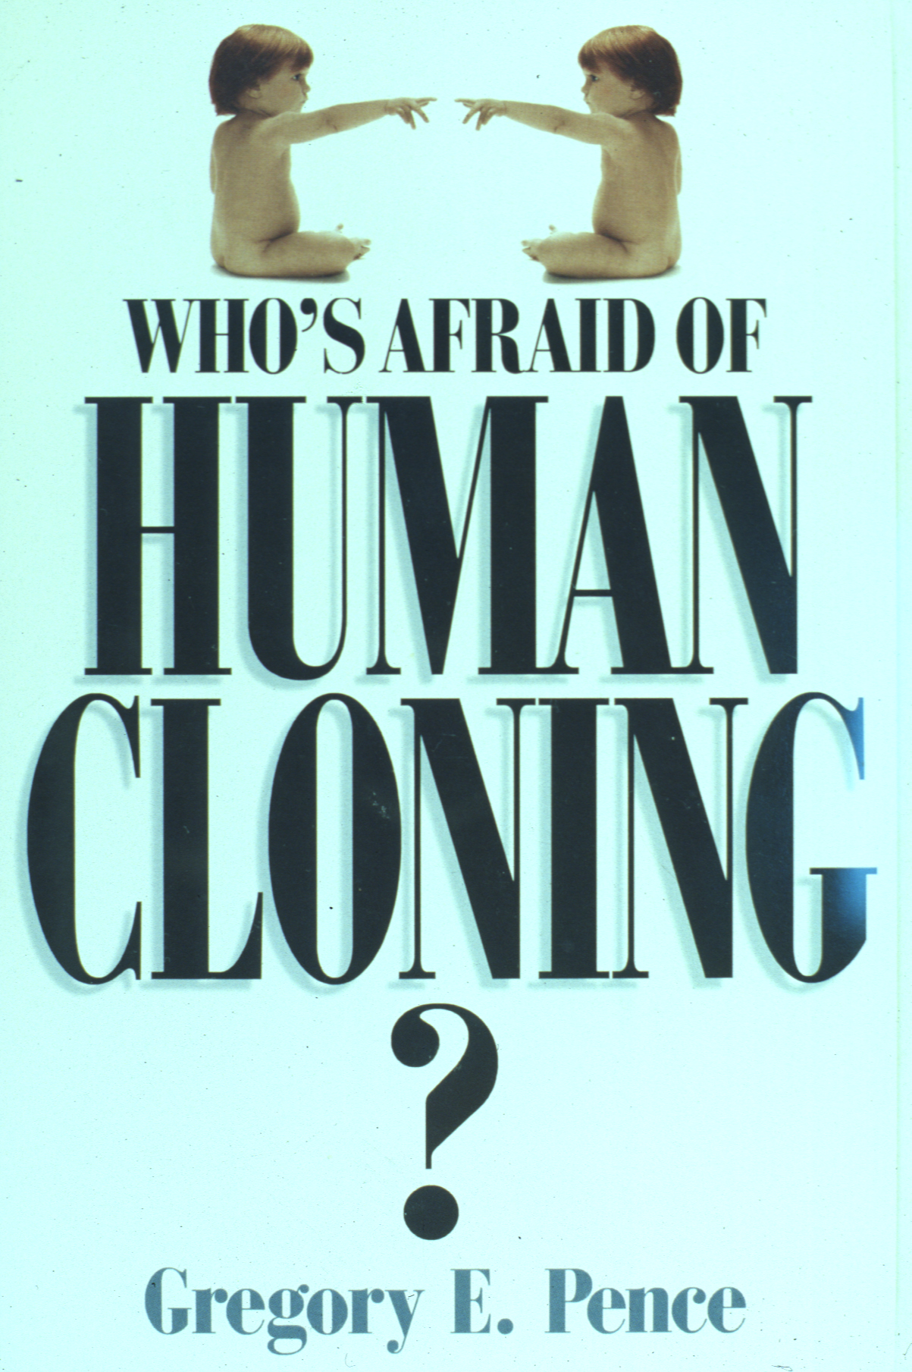
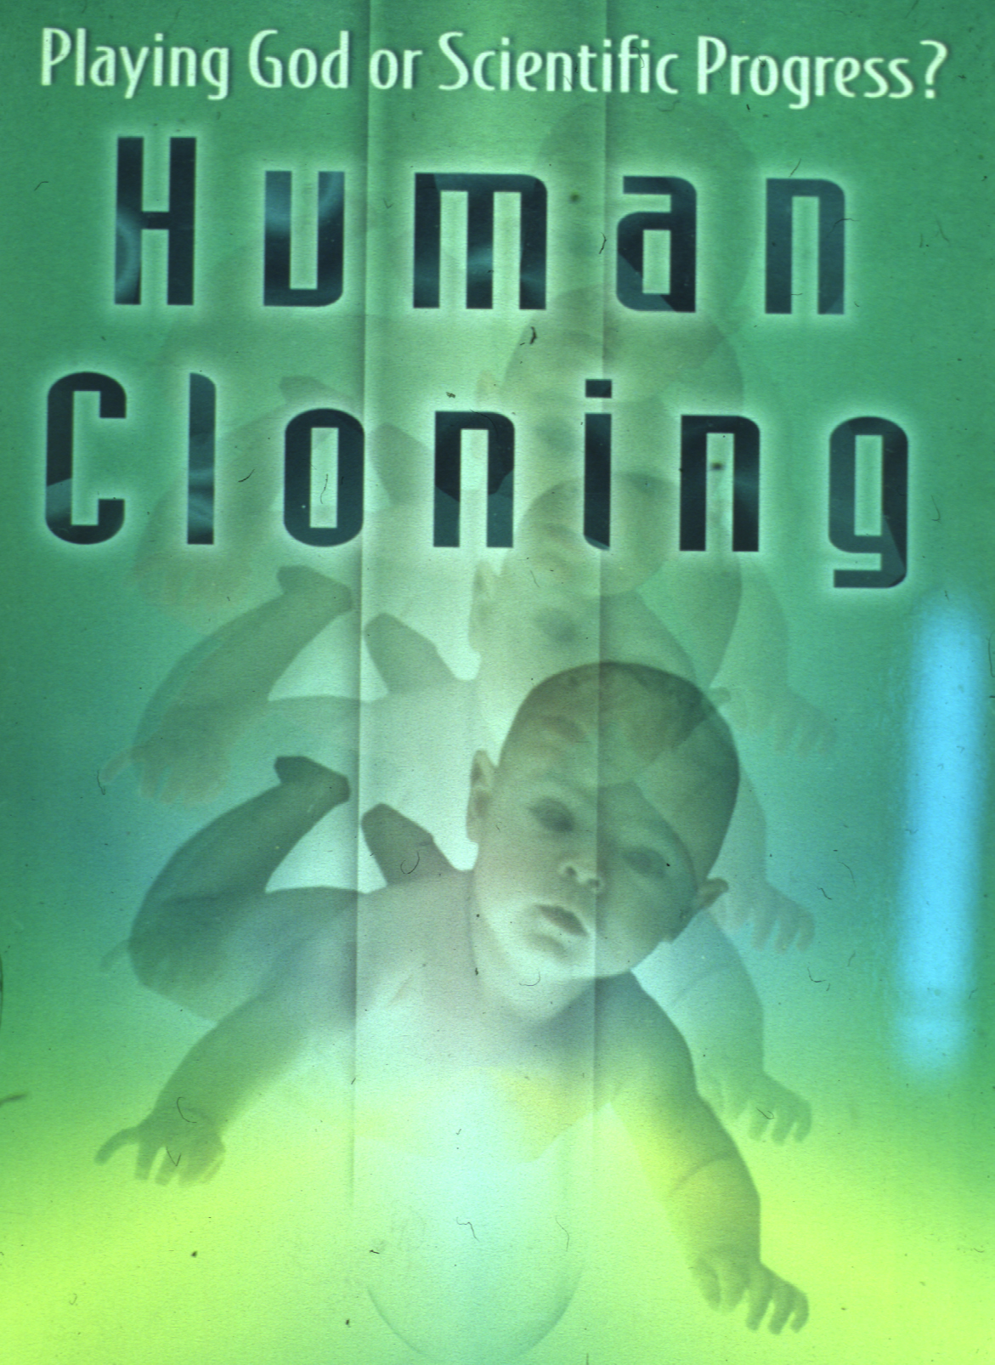

Slide 39
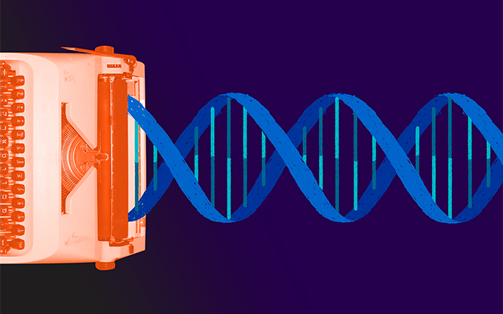

Slide 40
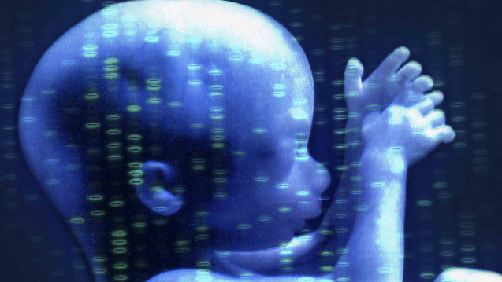

Slide 41
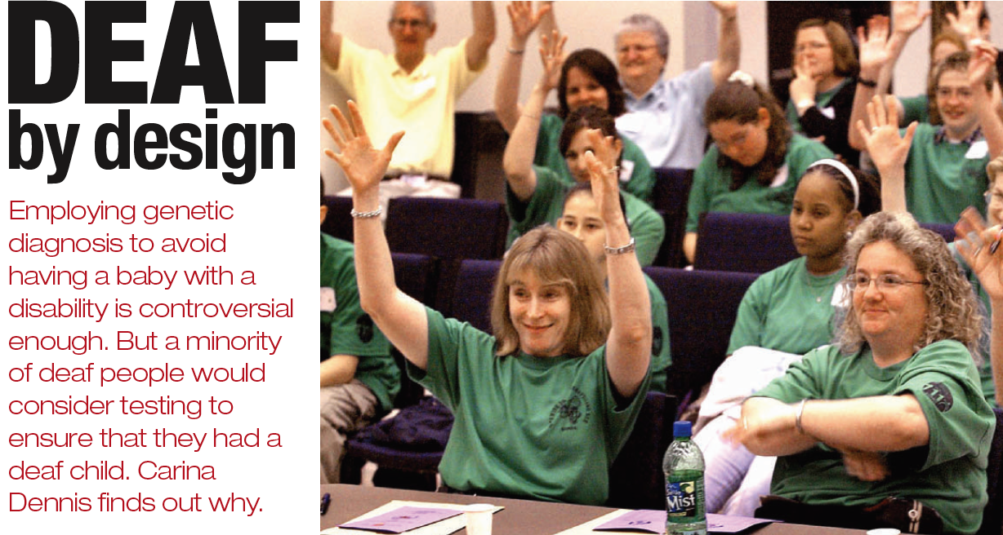
Sharon Duchesneau
Candy McCullough

Slide 42
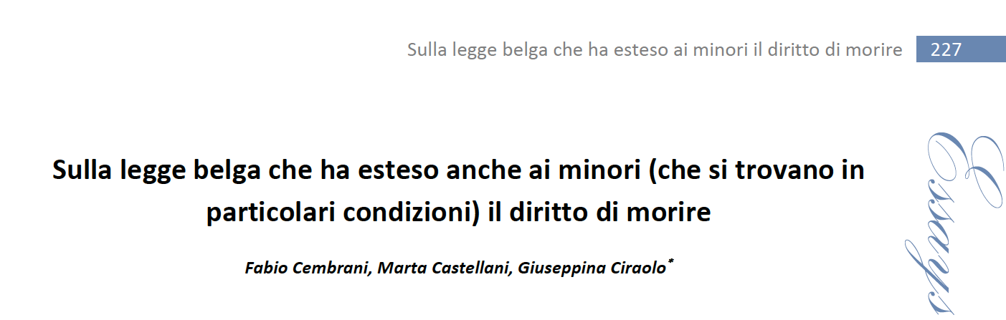

Slide 43
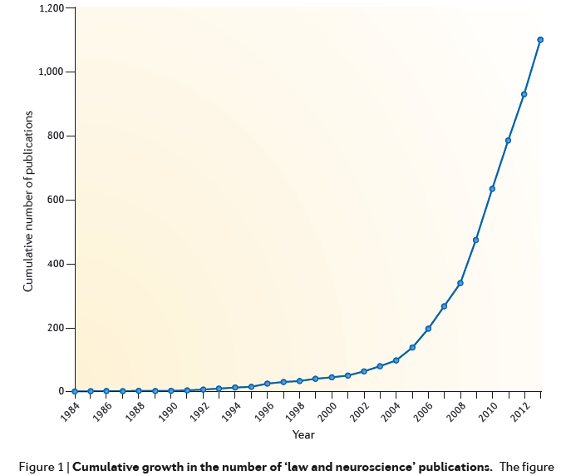

Slide 44
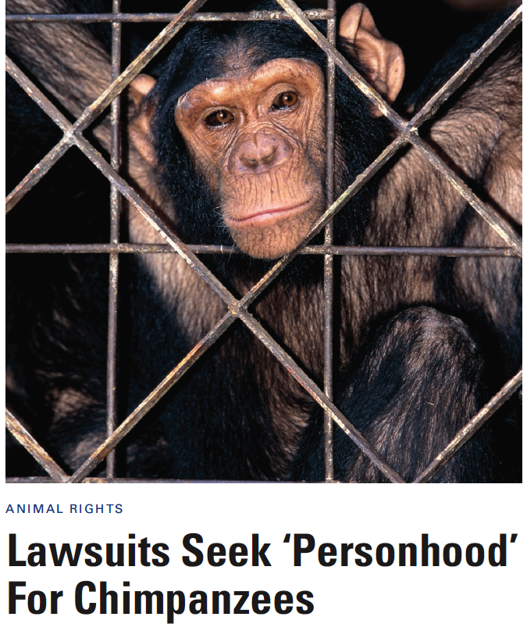
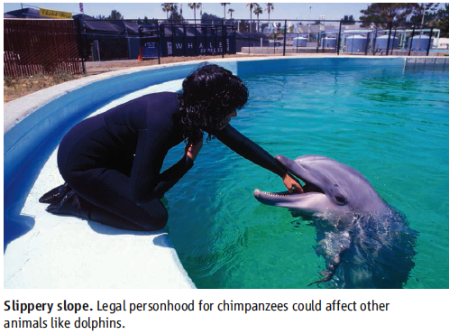
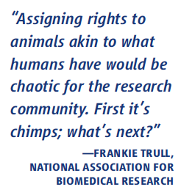

Slide 45
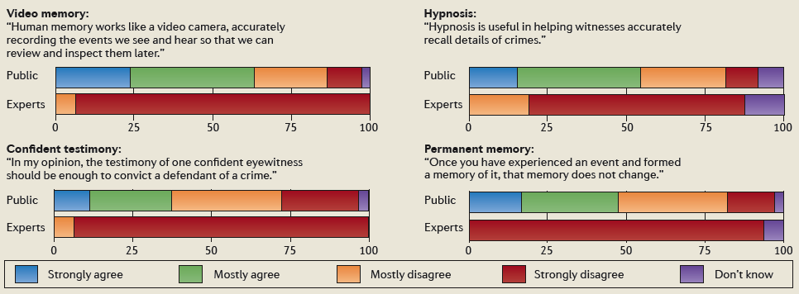
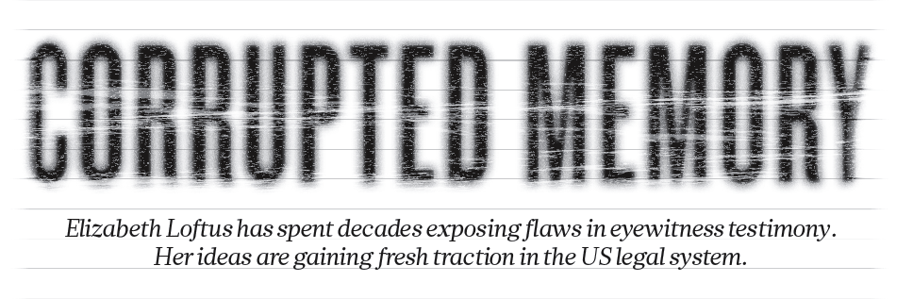

Slide 46
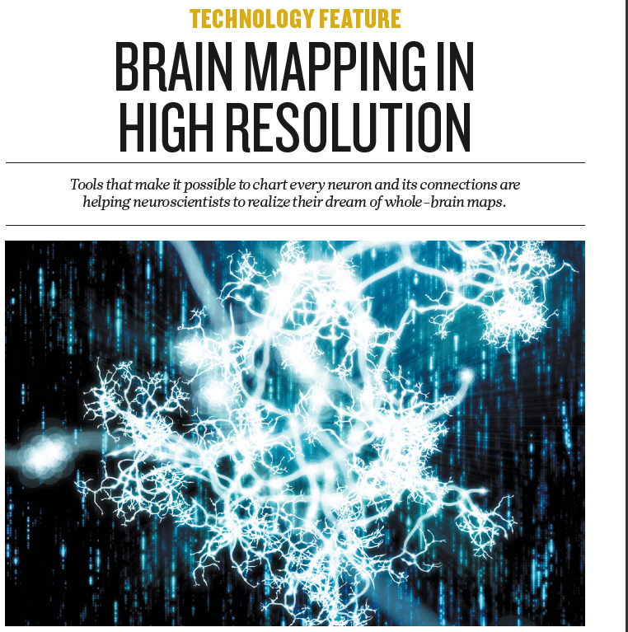

Slide 47
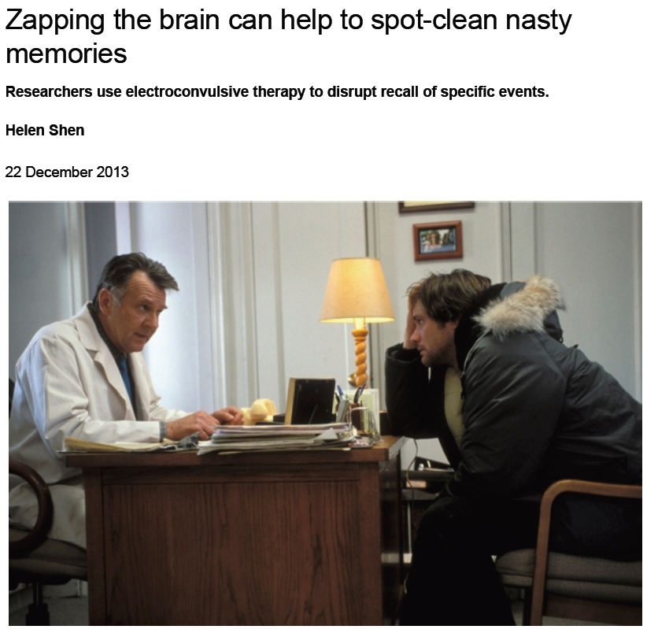

Slide 48
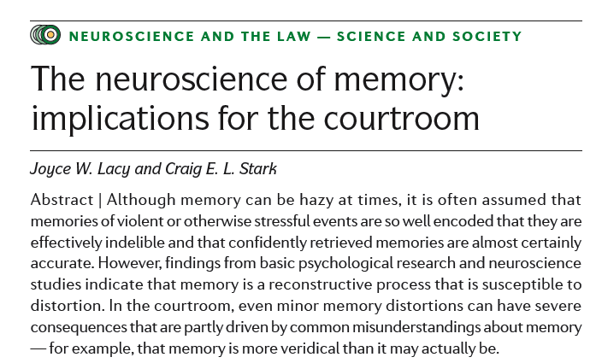



Slide 49
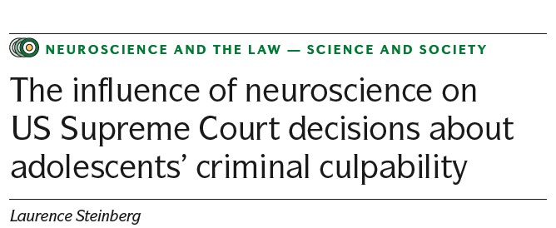
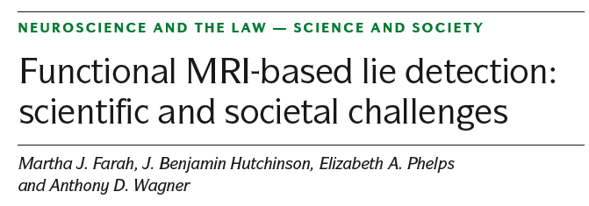

Slide 50
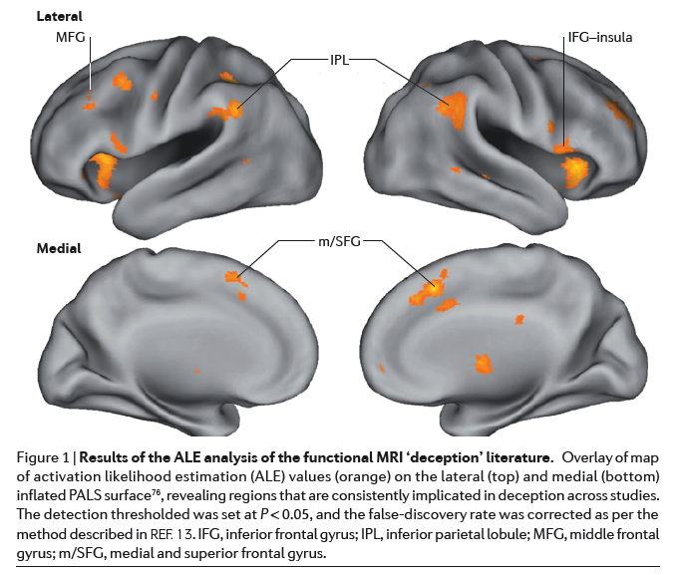

Slide 51


Slide 52


Slide 53


Slide 54


Slide 55



Slide 56



Slide 57




Slide 58


Slide 59


Slide 60


Slide 61


Slide 62



Slide 63




Slide 64


Slide 65

https://www.unipv-lawtech.eu/home.html

Slide 66


Slide 67


Slide 68


Slide 69


Slide 70


Slide 71





Slide 72
European Center for Law, Science and new technologies
Headquarters:
Università di Pavia - Laboratorio Biologia dello Sviluppo, Piazza Botta 9 – 27100 Pavia
Collegio Ghislieri, Piazza Ghislieri 5, 27100 Pavia (I)
https://www.unipv-lawtech.eu

Slide 73

GRAZIE !
per l’attenzione !

